Slide 1

Cyber Physical System for Environmental Monitoring and Crop Prediction
PROJECT MANUAL

Slide 2
Components Needed
DHT11
DHT Adafruit Library
Raspberry Pi
Python Compiler
Bread Board or Universal Soldering Board
Jumper Wires
Python Special Libraries
Micro SD Card and SD card Reader
Raspbian OS Image and Imager Software

Slide 3
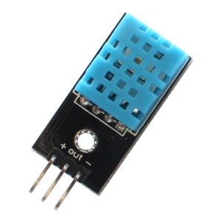
DHT11 (Some have 4 Pins it doesn’t matter)

Slide 4
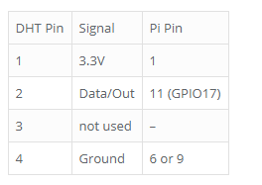
Raspberry pi Connection

Slide 5
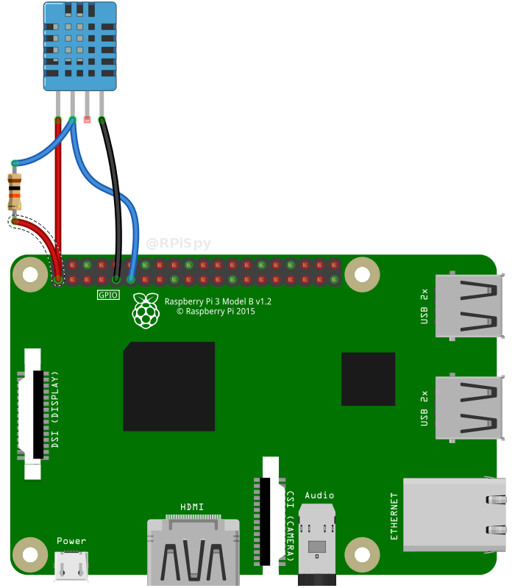
Raspberry Pi Connection

Slide 6
Software Setup
Unzip Cybernetics_Rpi.rar
Open Terminal and go to /Cybernetics _Rpi/ using cd cmds.
Type chmod +x setup.sh and press Enter.
Now type ./setup.sh and press Enter and wait for the Installation.
Now run Cyber Physical System.py

Slide 7
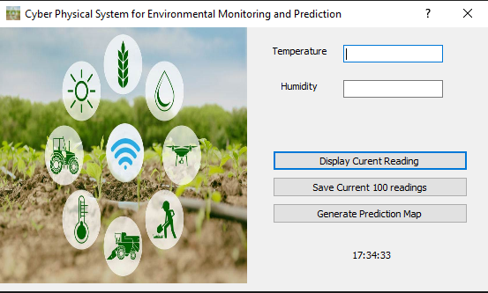
Software Preview

Slide 8
Button Operations
Click Display Current Reading to Get Current Reading.
Click Save Current 100 Readings to save current 100 readings to
/Data_Schema_Node/ SensorData.csv.
Click Generate Prediction Map to see the prediction Map.

Slide 9
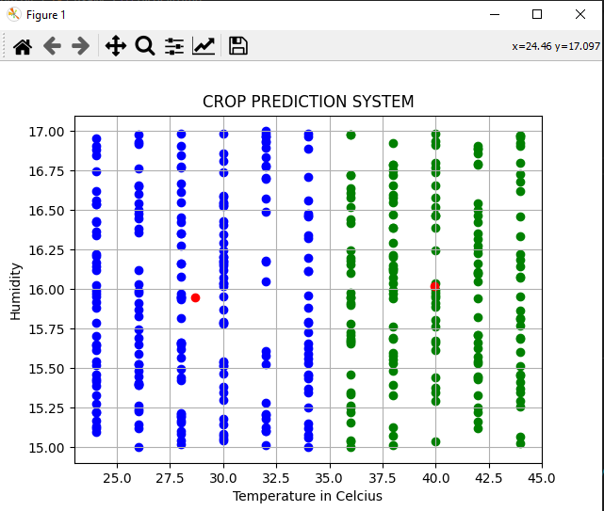
Prediction Map Sample Output

Slide 10
Thanks. Dvlpr ☺

